Slide 1
Simple algorithm for Chessboard recognition and internal grid analysis
By Claudio Tomaiuolo

Slide 2
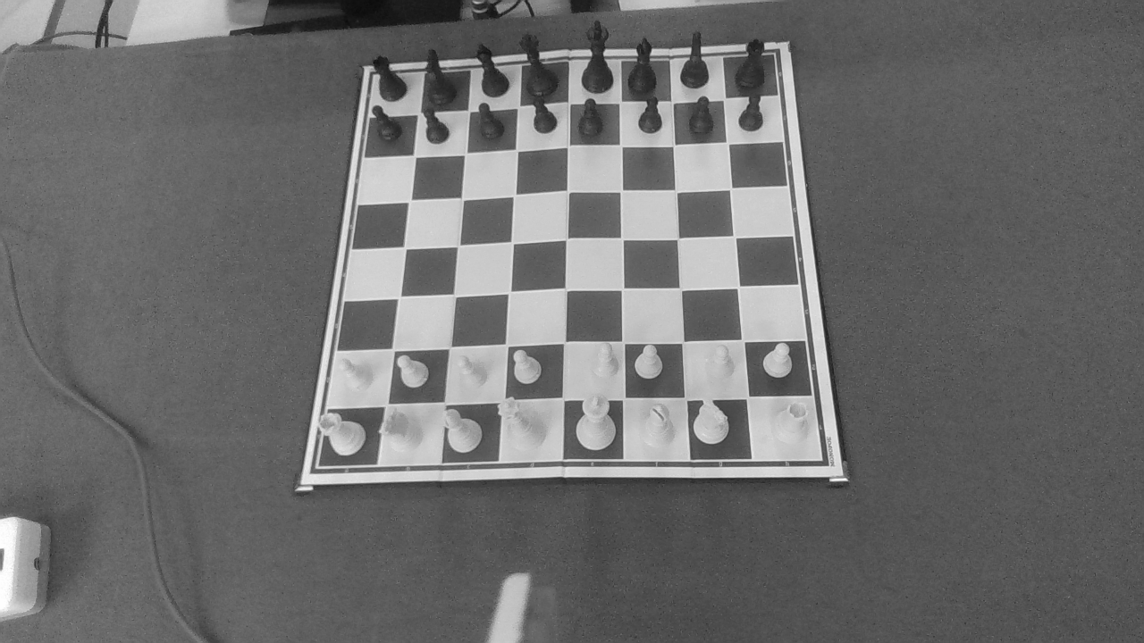
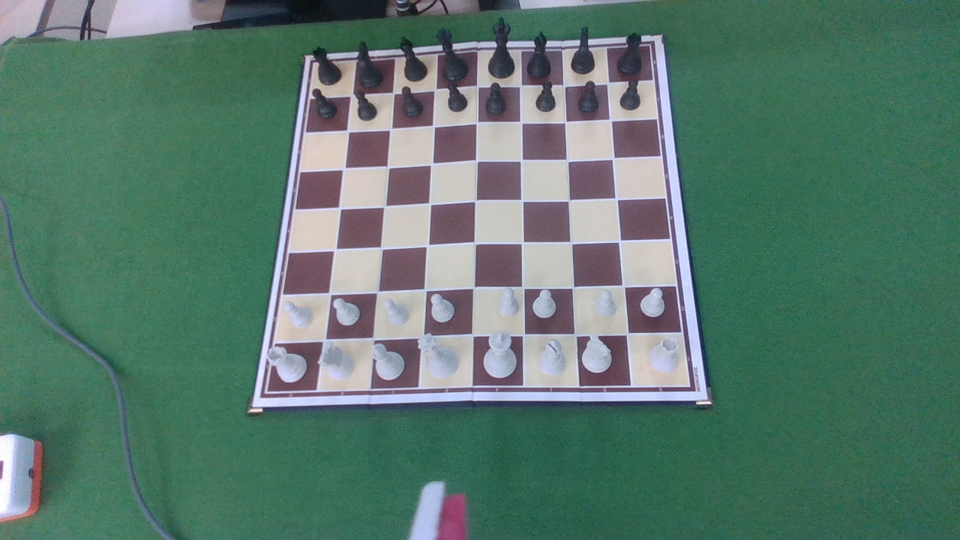
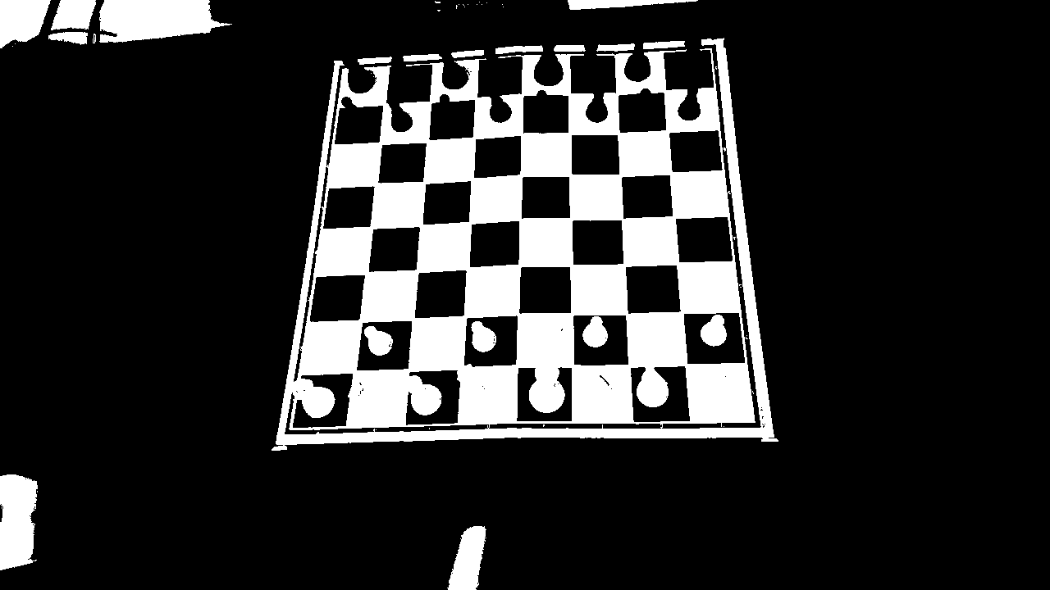



Chessboard Recognition
The Chessboard recognition system was developed from a paper at California Polytechnic State University, called Chess Piece Detection, by Craig Belshe (2021). From there, I made various changes and improvements.
Starting from a base image, the greyscale conversion function was applied, followed by a cv2.Threshold().

Slide 3
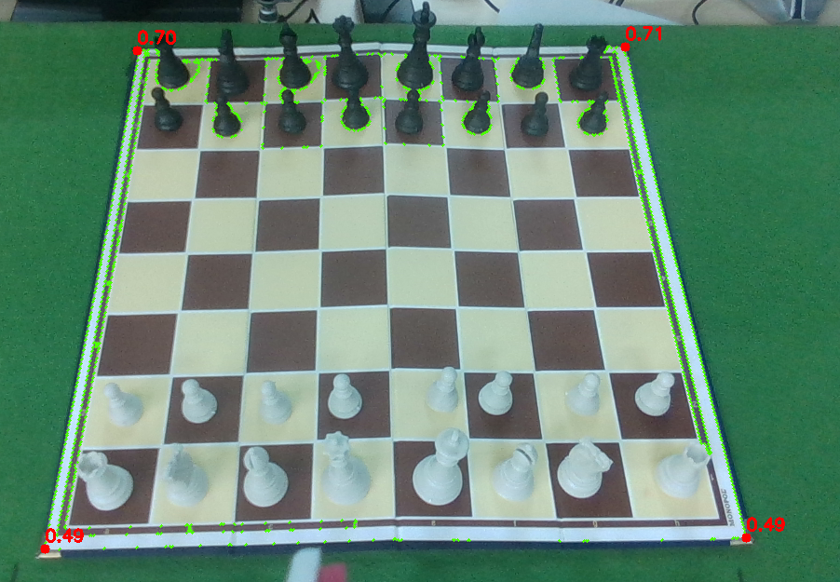
Next, the function cv2.findContours was applied, which searches the image for the various shapes given by the contrast between black and white.
From the shapes found, the one with the largest area is chosen (findChessBoard()).
From the chosen shape, I found the four extreme corners and, thanks to the features of the Intel RealSense camera, I applied the get_distance() function to receive the distance between the camera and the four corners, thinking that it could be used later to control the robot.
Below is the result obtained:

Slide 4
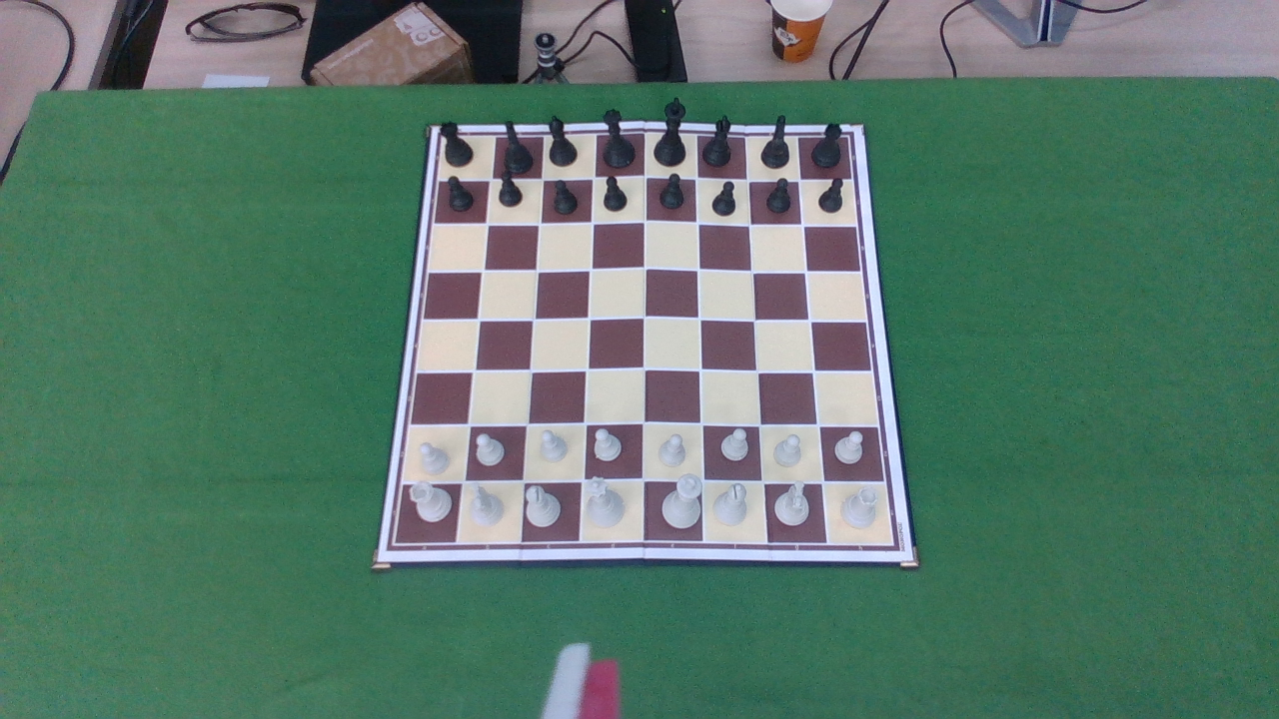
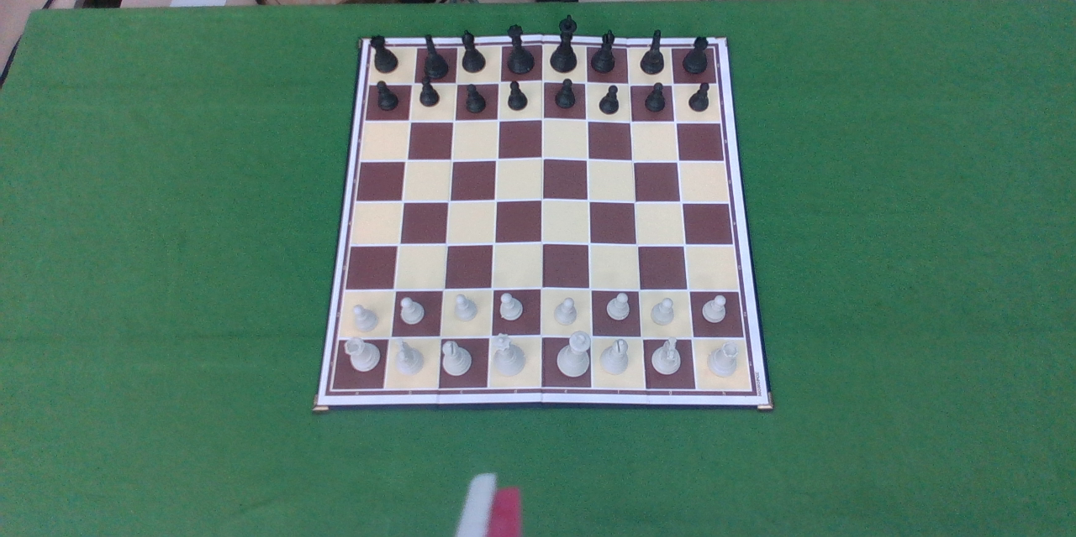

Tips:
By following a few small steps, we are sure that the system will recognise the Chessboard;
It’s possible to remove the green cloth, provided that the surface on which the Cheesboard is placed does not have any strange patterns or is not too dark in colour;
One must be sure that the largest recognisable shape with the largest area is the Cheesboard. One problem that can be found is that if the camera is looking at an angle perpendicular to the floor, there is a part off the table in the image. In that part, the system would find strange shapes with a larger area. Since the table and the robot have a fixed position, a solution could be to crop that part to avoid the problem (CropImage()). Also because we don’t need that part.

Slide 5
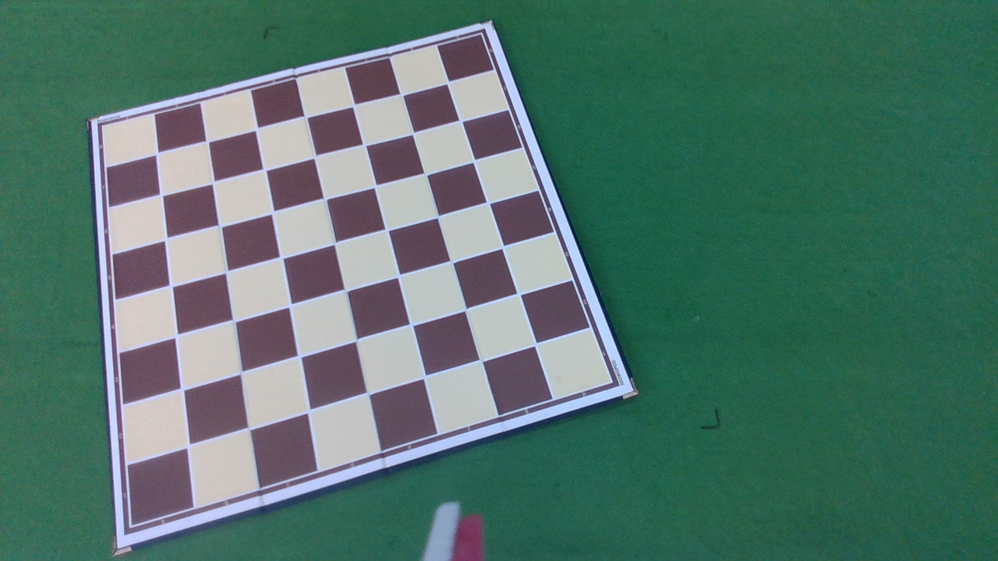
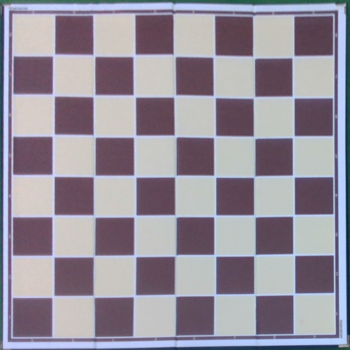

Grid analysis
To perform a grid analysis at whatever position the Chessboard is located, a perspective transformation function was applied (cv2.warpProspective()). The same function returns a smaller image with only the Chessboard inside.
Starting from the smaller image, cv2.Canny() was applied, followed by the Hough Line Transform.
In the paper, the Probabilistic Hough Line Transform was used, but was not efficient enough.

Slide 6
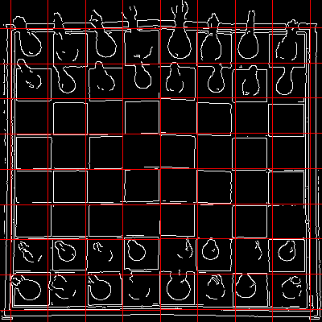
After the Hough Line Transform, I applied an algorithm to remove non-vertical or non-horizontal lines, then a second algorithm that finds neighbouring lines (DetectSimilarLines()) and returns one by averaging the positions (CentralLine()).
However, the result returned squares that were too different in size, so by finding the four main lines at the ends (FourMainLines()), I rebuilt the inner grid geometrically (RebuildGrid()).
Here is the result:

Slide 7
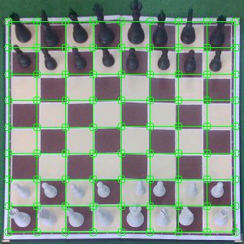
Next, I found all the intersections among the lines (FindIntersections()) and found all the squares that are formed at every four corners of the intersections.
The squares are saved in the 'squares' array in an orderly fashion, from A1 to H8.
In this way, I found all the quadrants of the Chessboard grid.

Slide 8
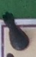
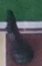
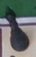
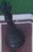
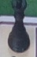
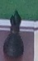
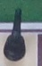
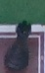

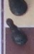
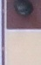
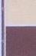
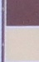
Once I had obtained all the squares, I saved them as images named 'A1.jpg' to 'H8.jpg' in the 'Squares/' folder. In this way, it is possible in the future to apply a neural network that recognises the pieces within the individual images.
The images were saved with a greater height than the squares in order not to cut off the heads of the taller pieces, due to the perspective of the camera.

Slide 9
Future works:
In order to detect pieces, three methods could be implemented for this algorithm, or even a combinations of the three methods:
An artificial neural network model;
The depth features of the Intel RealSense camera;
cv2.inRange() function.

Slide 10
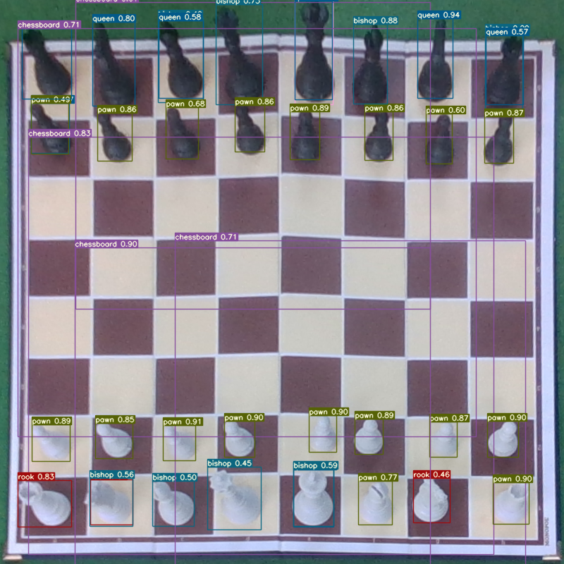
The use of a well-trained neural network model with Yolo for recognising the pieces within the complete Chessboard image or searching for the pieces within the individual images of each of the squares detected.

Slide 11
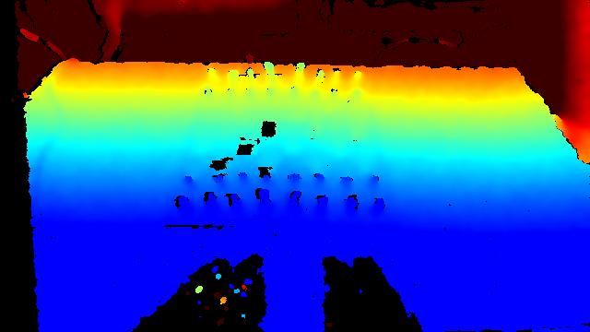
Using the depth features of the Intel RealSense camera, taking into account noise and parts where it sometimes fails to recognise the distance. Testing the capacity of the camera, it can be seen that between the head of a piece and the Chessboard there is a difference in depth of between 20 and 40 millimetres. So it is a capability that could be exploited in some way.

Slide 12
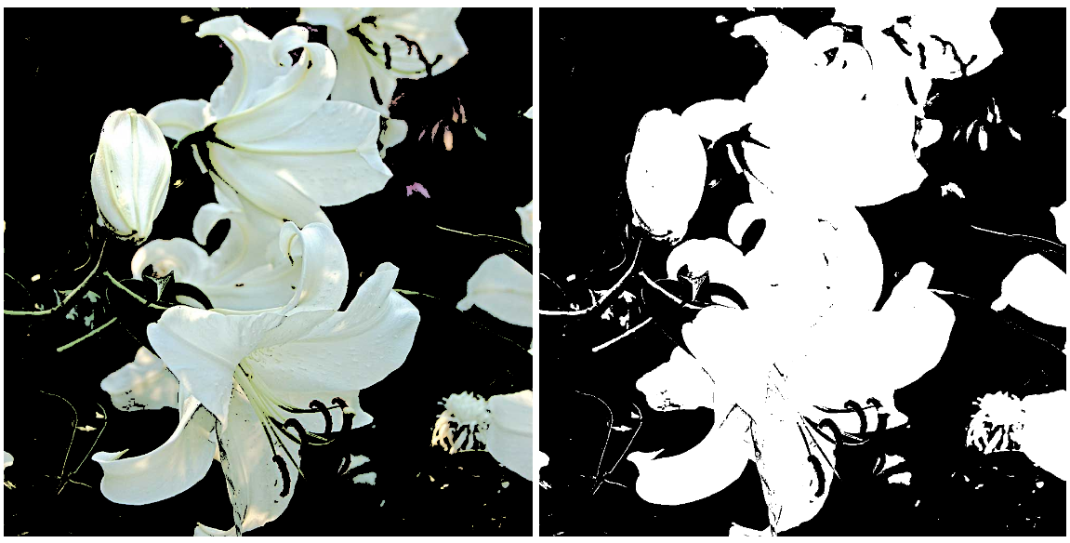
Search within the squares if there are black or white shapes via the function cv2.inRange(). By deciding on the sensitivity of white or black, it is possible to detect those colours in the squares and understand whether that square is occupied or not.

Slide 13
Thanks for your attention
by Claudio Tomaiuolo

